Slide 1
AI Based Card less ATM Transaction using Face Recognition
TEAM MEMBERS:
SUDHAKAR S
SATHISH KUMAR P
RAJAMANICKAM R
PROJECT GUIDE: Mrs.J.PRISKILLA ANGEL RANI

Slide 2
Objective
To design and implement a face recognition based ATM Transaction System using Convolutional Neural Network.

Slide 3
Introduction
ATM (Automated Teller Machine) is generally used for withdrawal of money from our Bank account without going to the bank. By means of ATM which is used as an agent through which we can access our bank account remotely by providing atm card details with a proper PIN, one can withdraw, deposit or check the account balance.
But in today’s ATM technology there is always a chance of stealing money. The money can easily be stolen if one gets the access to ATM card and security pin number rather there is always a chance of losing ATM card and during that period withdrawal of money gets difficult.
In addition to it we always have to carry ATM card everywhere we go and only one person can have access to the card which sometimes can get pretty difficult .when members of the same family want to withdraw cash, who are at different locations.

Slide 4
Introduction
In addition, if you are a totally new in area or country and the purse you are carrying in which all of your cash and ATM card are kept gets stolen then undoubtedly it will be the worst situation to survive.
To overcome such drawbacks the idea of a card-less ATM which uses face recognition for authorization and authentication of user seems quite useful and reliable.
For instance, if two members of the same family are at the different location of a country then both of them can have access to the same account anywhere and anytime they want without carrying an ATM card.
In this technology, we take user's face-print as a replacement for ATM card

Slide 5
Abstract
The current ATM (Automated Teller Machine) system uses ATM card and PIN (Pin Identification Number) for authentication.
This system is likely to be harmed by many security issues such as theft of ATM card, skimming, Lebanese loop etc.
So in this project, we propose a system that uses face recognition authentication (not ATM cards) for accessing user account along with PIN which is more secure and reliable than the existing system. Here we are using the CNN model(Deep Learning Model) for face recognition.

Slide 6
Literature Survey 1
Title | Author | Year | Description
Resolution Invariant Face Recognition using a Distillation Approach | Syed Safwan Khalid, Muhammad Awais, Zhen-Hua Feng, Member, IEEE Chi-Ho Chan, Ammarah Farooq, Ali Akbari and Josef Kittler Life Member, IEEE | 2020 | In this project they propose to train a network using both HR and LR images under the guidance of a fixed network, pretrained on HR face images. The guidance is provided by minimising the KL-divergence between the output Softmax probabilities of the pretrained (i.e., Teacher) and trainable (i.e., Student) network as well as by sharing the Softmax weights between the two networks.

Slide 7
Literature Survey 2
Title | Author | Year | Description
FAN: Feature Adaptation Network for Surveillance Face Recognition and Normalization | Xiaoming Liu Michigan State University | 2019 | This paper studies face recognition (FR) and normalization in surveillance imagery. Surveillance FR is a challenging problem that has great values in law enforcement. Despite recent progress in conventional FR, less effort has been devoted to surveillance FR. To bridge this gap, we propose a Feature Adaptation Network (FAN) to jointly perform surveillance FR and normalization

Slide 8
Literature Survey 3
Title | Author | Year | Description
A Fast and Accurate System for Face Detection, Identification, and Verification | Rajeev Ranjan, Ankan Bansal, Jingxiao Zheng, Hongyu Xu, Joshua Gleason, Boyu Lu, Anirudh Nanduri, Jun-Cheng Chen, Carlos D. Castillo, Rama Chellappa | 2015 | In this paper, they describe the details of a deep learning pipeline for unconstrained face identification and verification which achieves state-of-the-art performance on several benchmark datasets. We propose a novel face detector, Deep Pyramid Single Shot Face Detector (DPSSD), which is fast and capable of detecting faces with large scale variations (especially tiny faces).

Slide 9
Existing System
In the existing system they used pretrained weight for detecting high range and low range face images, their accuracy also not a stable one.

Slide 10
Proposed system
In the Proposed system we used a deep learning technique which is called as Convolutional Neural Network to recognize the face. Here we are using Deep Neural Network Architecture. And hence we can able to get a high and stable accuracy. We able to get occcuracy of above 90%.

Slide 11
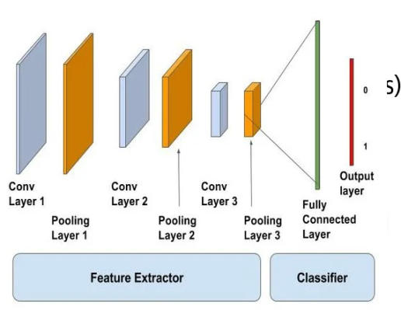
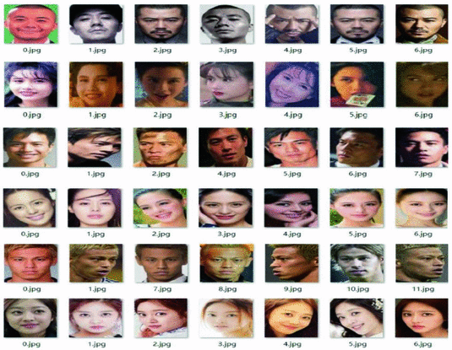

Proposed System Architecture
Pre processing
Input Face Dataset
Training Using Convolutional Neural Network
Trained Model
Testing using the trained model
And move forward for ATM Transaction

Slide 12
TRAINING
Convolutional
Neural Network
Pre-processing
Convolutional Layer
Rescaling
Shearing
Max Pooling Layer
Input Training Images
Trained Model
Zooming
Flattening Layer
Horizontal Flipping
Fully connected Layer with Multiple Hidden Layer

Slide 13
TESTING
Input Face Image
User ID and Bank Details
Trained Model
Make ATM Transaction
Comparing face and pin
Getting 4 digit pin

Slide 14
Module Description
In our project at first we are going to collect the user’s face images we will capture each users face for 50 times and all the 50 images are stored in the separate folder.
The collected face images of users are used for Training purpose and validation purpose.
After data collection the user’s face images are pre-processed by using pre-processing techniques such as zooming, shearing, rescaling and horizontal flipping.
These pre-processed data’s are then feeded into our Convolutional Neural Network model.
Training Process is conducted by using Convolutional Neural Network and the trained model is saved as a file for testing purpose

Slide 15
Module Description
In our project we will train the image datas for more than 100 times to reach the 97% occuracy.
After training we can able to classify the users faces in real time by using the trained model.
Testing a image using our trained model will also give 97% occurate result.
Once the users image is predicted, then their banking details are getted and then the machine asks for the 4 digit secret pin from the user to continue the transaction.
If their face and 4 digit pin number is matched, then they can able to make transaction, if it is not mached then they can’t able to make transactions in the ATM.

Slide 16
Algorithm

Slide 17
DEEP LEARNING
Deep learning (also known as deep structured learning) is part of a broader family of machine learning methods based on artificial neural networks with representation learning.
Learning can be supervised, semi-supervised or unsupervised.
Deep learning architectures such as deep neural networks, deep belief networks, recurrent neural networks and convolution neural networks have been applied to fields including computer vision, machine vision, speech recognition, natural language processing, audio recognition, social network filtering, machine translation, bioinformatics, drug design, medical image analysis, material inspection and board game programs, where they have produced results comparable to and in some cases surpassing human expert performance.

Slide 18
CNN
In deep learning, a convolutional neural network (CNN, or ConvNet) is a class of deep neural networks, most commonly applied to analyzing visual imagery.
They are also known as shift invariant or space invariant artificial neural networks (SIANN), based on their shared-weights architecture and translation invariance characteristics.
They have applications in image and video recognition, recommender systems, image classification, medical image analysis, natural language processing, and financial time series.

Slide 19
CNN
CNNs are regularized versions of multilayer perceptrons. Multilayer perceptrons usually mean fully connected networks, that is, each neuron in one layer is connected to all neurons in the next layer.
The "fully-connectedness" of these networks makes them prone to overfitting data.
Typical ways of regularization include adding some form of magnitude measurement of weights to the loss function.
CNNs take a different approach towards regularization: they take advantage of the hierarchical pattern in data and assemble more complex patterns using smaller and simpler patterns.
Therefore, on the scale of connectedness and complexity, CNNs are on the lower extreme.

Slide 20
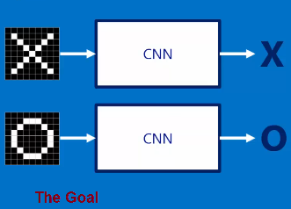
So, What about the Computer? CNN?
Learning…
X
O
Here CNN work as like black box, so what is inside the black box!
© UMANG KEJRIWAL

Slide 21
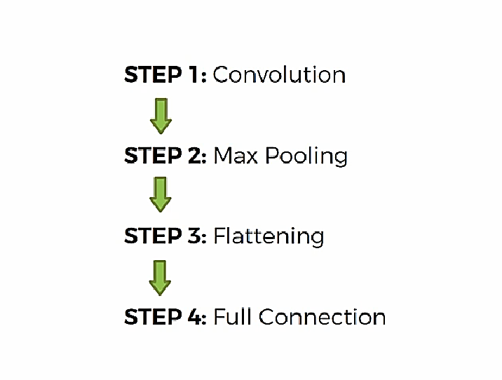
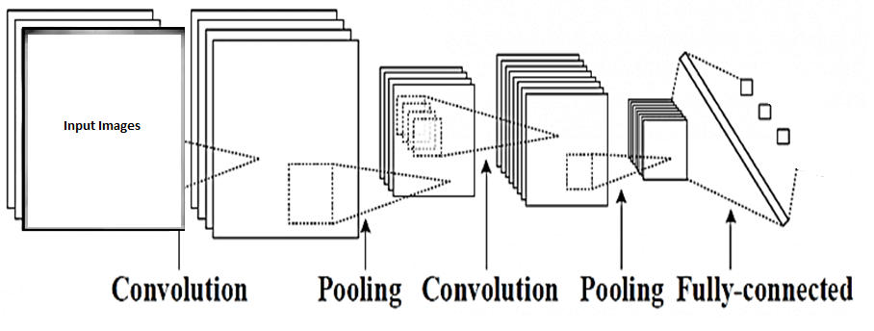
Steps in CNN
© UMANG KEJRIWAL

Slide 22
Tools Used
Hardware Tools
A PC which runs with windows operating system
Software Tools
Python IDE
Software package
matplotlib
Numpy
Sklearn
tensorflow
opencv

Slide 23
Conclusion
In our project, we created a model which can authenticate user by using their we used deep learning technique and hence we got an accuracy of over 95% and its output is stable.
In future work we will add some extra hardware modules to view it as real. And we will increase the accuracy of the model by using hybrid deep learning models.

Slide 24
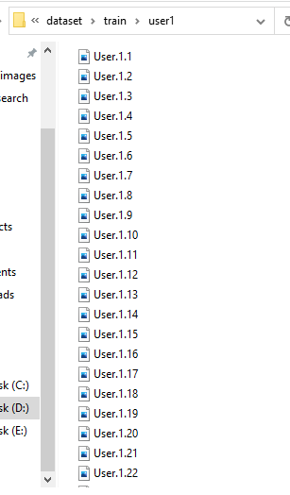
Result (Training datas)

Slide 25
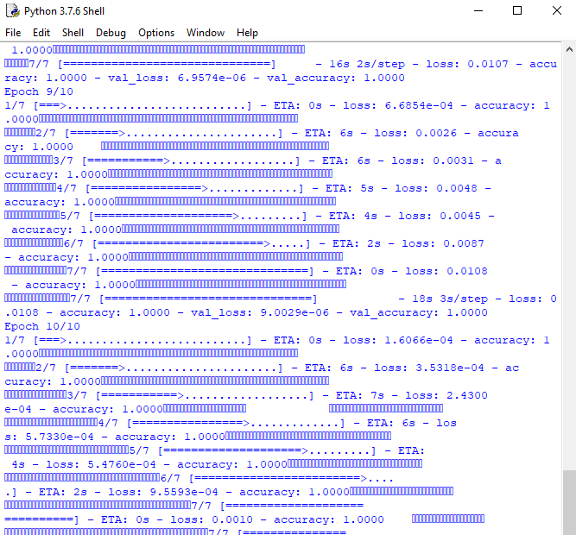
Training process

Slide 26
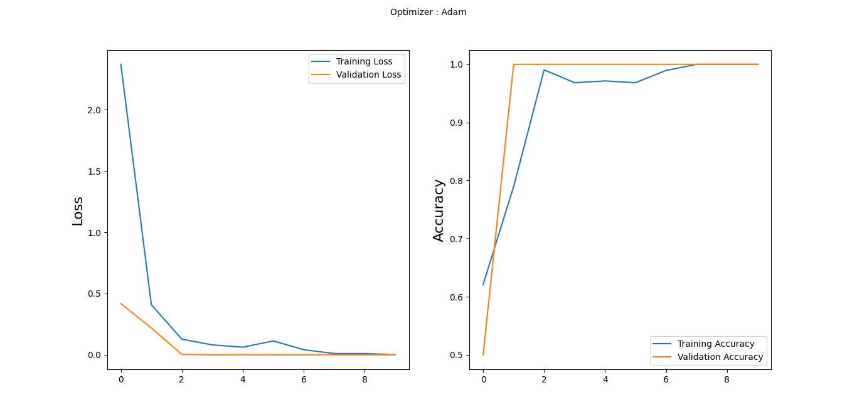
Loss vs accuracy graph

Slide 27
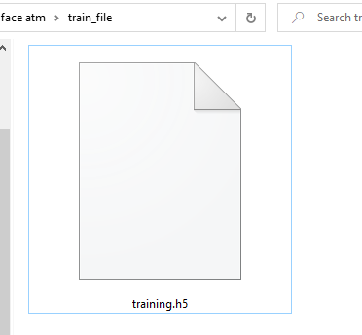
Trained Model

Slide 28
References
[1] T. Ahonen, A. Hadid, and M. Pietikainen, “Face description with local
binary patterns: Application to face recognition,” IEEE transactions on
pattern analysis and machine intelligence, vol. 28, no. 12, pp. 2037–
2041, 2006.
[2] J. Lu, V. E. Liong, X. Zhou, and J. Zhou, “Learning compact binary face
descriptor for face recognition,” IEEE transactions on pattern analysis
and machine intelligence, vol. 37, no. 10, pp. 2041–2056, 2015.
[3] X. Song, Z.-H. Feng, G. Hu, and X.-J. Wu, “Half-face dictionary
integration for representation-based classification,” IEEE Transactions
on Cybernetics, vol. 47, no. 1, pp. 142–152, 2017.
[4] P. Koppen, Z.-H. Feng, J. Kittler, M. Awais, W. Christmas, X.-J. Wu,
and H.-F. Yin, “Gaussian mixture 3d morphable face model,” Pattern
Recognition, vol. 74, pp. 617–628, 2018.
[5] X. Song, Z.-H. Feng, G. Hu, J. Kittler, and X.-J. Wu, “Dictionary integration
using 3d morphable face models for pose-invariant collaborativerepresentation-
based classification,” IEEE Transactions on Information
Forensics and Security, vol. 13, no. 11, pp. 2734–2745, 2018.
[6] Y. Taigman, M. Yang, M. Ranzato, and L. Wolf, “Deepface: Closing the
gap to human-level performance in face verification,” in Proceedings of
the IEEE conference on computer vision and pattern recognition, 2014,
pp. 1701–1708.
[7] H. Wang, Y. Wang, Z. Zhou, X. Ji, D. Gong, J. Zhou, Z. Li, and
W. Liu, “Cosface: Large margin cosine loss for deep face recognition,”
in Proceedings of the IEEE Conference on Computer Vision and Pattern
Recognition, 2018, pp. 5265–5274.

